Slide 1

Priority-Driven Task Scheduler
DSA PRACTICAL ASSIGNMENT
Student Name: P. I. Tharindu Gamage
Student Registration Number: UWU/ICT/24/093
Submission Date: July 18th, 2026

Slide 2

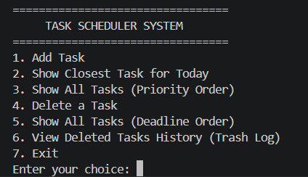
Project Overview
An efficient 7-option framework for personal task prioritization and chronological scheduling

Slide 3

Problem Statement
The Challenge
Flat sequential registers require a sluggish $O(n)$ search time to isolate high-priority items. Additionally, volatile execution runtime results in permanent task data loss when sessions exit.
The Solution
A comprehensive Java CLI Scheduler utilizing custom data structures (Min-Heap, Stack, and lists) coupled with date-math routines and direct flat-file tracking persistence.

Slide 4


System Architecture
7-Option Command Interface: Streamlined main menus for scheduling, tracking, and sorting.
Core System Processor: Central engine managing algorithms and chronological math.
Flat File Persistence: Keeps disk storage records current through automatic read/write cycles.

Slide 5




Core Data Structures
Min-Heap
LIFO Stack
ArrayList
Our priority engine. Keeps the most urgent task (Priority 1) at the root, enabling super-fast lookup and balance speeds.
The system's Trash Bin. Pushes deleted items onto a custom-managed stack to compile a robust session-wide audit log.
Flat sequential list wrapper used during iterative sorting routines and index selections in CLI menus.

Slide 6

Algorithmic Efficiency
O(log n)
Insertion & Deletion Speeds
Logarithmic Scaling
Leveraging a balanced binary tree model allows our heapify algorithms to process insertions and extractions quickly along tree levels. Even with hundreds of tasks, priority adjustments are completed in milliseconds.

Slide 7


The Insertion Process
New tasks are placed initially at the lowest, rightmost leaf.
Heapify Up checks if the parent node's priority values are lower.
Recursively swaps nodes up the heap until proper parent order is satisfied.
Mathematical Parent Mapping
Maps hierarchical relationships using zero-indexed arrays:

Slide 8



Deadline Analytics
Closest Task Logic
Computes the absolute difference in days between today's system clock and scheduled task targets:
Chronological Sort
Runs a custom Bubble Sort algorithm. Loops through task dates, parses strings into LocalDate objects, and rearranges items sequentially without affecting original heap priority values.

Slide 9

Complexity Matrix
Feature Operation | Custom Data Structure | Best Case | Worst Case
Add New Tasks | Min-Heap Insertion (Heapify Up) | $O(1)$ | $O(\log n)$
Show Closest Task | Linear Date Difference Scan | $O(n)$ | $O(n)$
Show All Tasks (Priority) | Min-Heap extraction + ArrayList | $O(n)$ | $O(n \log n)$
Show All Tasks (Deadline) | ArrayList + Temporal Bubble Sort | $O(n)$ | $O(n^2)$

Slide 10
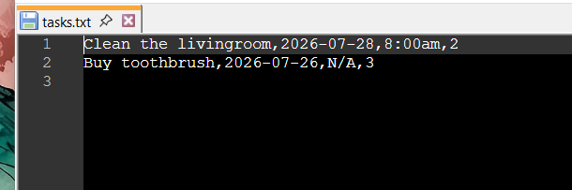
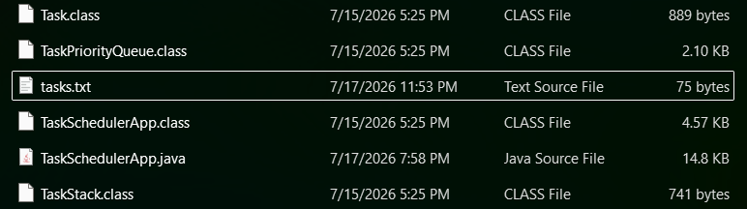
File Persistence
The scheduler ensures user data is saved dynamically in tasks.txt. Changes are updated locally after every execution.
Saves states dynamically when records change.
Auto-loads saved tasks when the application starts.
Deleted items are temporarily kept in memory inside a **LIFO Stack** for easy session review.

Slide 11



Challenges & Lessons
Pointer Math
Date Formatting
Stream Integrity
Carefully managing indices during heap deletions resolved out-of-bounds exceptions while restructuring the binary heap array.
Standardized string-based deadlines using robust LocalDate formatters, preventing parse errors from invalid CLI entries.
Utilized stream checks to gracefully handle empty storage files and avoid null pointer exceptions during application startup.

Slide 12

Questions?
GitHub Code Repository Link:
https://github.com/ict24093-rgb/Task-Scheduler.git
P. I. Tharindu Gamage| UWU/ICT/24/093 Uva Wellassa University of Sri Lanka

